Slide 1
Fundamental Theorem of Calculus
By: Kianna and Aubrey

Slide 2
Faster Way?
Fundamental Theorem of Calc
Rectangles or Trapezoids

Slide 3
Formal Definition
If f is an integrable function and if , then

Slide 4
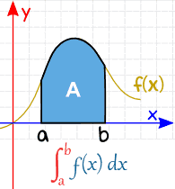
Informal Definition
Evaluating definite integrals
Accumulation under a curve to the x axis
Subtracting the upper boundary by the lower boundary

Slide 5
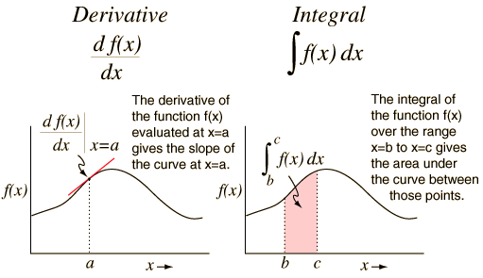
Conceptual Meeting
Establishes the inverse relationship between derivatives and integrals
Gives an easy way to evaluate definite integrals

Slide 6
Example Question
$$\int_{1}^{3}{\sqrt{x}}∗dx$$
$$\int_{1}^{3}{x^{1/2}∗dx}$$
$$→$$
$$→$$
$$\frac{2}{3}x^{3/2}+c|_{1}^{3}$$
The units are squared because FTC calculates the accumulation under the curve (area)
$$\left[\frac{2}{3}{(3)}^{3/2}+c\right]−\left[\frac{2}{3}{(1)}^{3/2}+c\right]$$
$$FTC$$
$$→$$
$$=2.7974 {un}^{2}$$

Slide 8
Handout
Solve the definite integral on the handout and flip your paper over when you are done

Slide 9
Solution
$$\int_{12}^{15}{\sqrt{5x+9}}∗dx$$
$$\int_{12}^{15}{{(5x+9)}^{1/2}∗dx}$$
$$→$$
$$u=5x+9$$
du = 5*dx
$$\int_{12}^{15}{{(u)}^{1/2}∗dx}$$
$$=\frac{2}{3}∗\frac{1}{5}{\left(5x+9\right)}^{\frac{3}{2}}+c |_{12}^{15}$$
$$= \frac{2}{15}{(5x+9)}^{3/2}+c |_{12}^{15}$$
$$\left[\frac{2}{15}{(5(15)+9)}^{3/2}+c\right]−\left[\frac{2}{15}{(5(12)+9)}^{3/2}+c\right]$$
$$FTC$$
$$→$$
$$=26.2288 {un}^{2}$$

Slide 10
Real World Simulation
The velocity of Maggie is represented by $v\left(t\right)= t^{2}−9t+10$ where t represents time and velocity is ft/sec. Find the distance and displacement of Maggie from time $\left[1,3\right] seconds$.

Slide 11
Derivative or Integral?
Rate of change
Accumulation over time

Slide 12
Solution: Displacement
$v\left(t\right)= t^{2}−9t+10 from \left[1,3\right]$
Displacement
$$\int_{1}^{3}{t^{2}−9t+10 ∗dt}$$
$$=\frac{1}{3}t^{3}−\frac{9}{2}t^{2}+10t+c|_{1}^{3}$$
$$=\left[\frac{1}{3}{(3)}^{3}−\frac{9}{2}{\left(3\right)}^{2}+10(3)+c\right]−\left[\frac{1}{3}{\left(1\right)}^{3}−\frac{9}{2}{\left(1\right)}^{2}+10\left(1\right)+c\right]$$
$$=−7.3333 ft$$

Slide 13
Solution: Distance
$v\left(t\right)= t^{2}−9t+10 from \left[1,3\right]$
Distance
(1.3,0)
$$\int_{1}^{3}{\left|t^{2}−9t+10\right|∗dt}$$
$$=\int_{1}^{1.3}{v\left(t\right)∗dt+\int_{1.3}^{3}{v(t)∗dt}}$$
$$=\left|\frac{1}{3}t^{3}−\frac{9}{2}t^{2}+10t+c|_{1}^{1.3}\right|+\left|\frac{1}{3}t^{3}−\frac{9}{2}t^{2}+10t+c|_{1.3}^{3}\right|$$
$= \left[\left[\frac{1}{3}{(1.3)}^{3}−\frac{9}{2}{\left(1.3\right)}^{2}+10(1.3)+c\right]−\left[\frac{1}{3}{(1)}^{3}−\frac{9}{2}{\left(1\right)}^{2}+10(1)+c\right]\right]$-
+$\left[\left[\frac{1}{3}{(3)}^{3}−\frac{9}{2}{\left(3\right)}^{2}+10(3)+c\right]−\left[\frac{1}{3}{(1.3)}^{3}−\frac{9}{2}{\left(1.3\right)}^{2}+10(1.3)+c\right]\right]$
$$=7.9551 ft$$

Slide 14
What does this mean?
Maggie traveled a distance of 7.9551 ft, but had a displacement of -7.3333 ft over the course of $\left[1,3\right]$ seconds
Start
Finish

Slide 15
Citations
Dumaw, Hayden. “The Fundamental Theorem of Calc (FTC) | Humble Calculus Parody (Music Video).” YouTube, YouTube, 25 May 2017, www.youtube.com/watch?v=8OrgwbgLiw0.
Nave, R. “Derivatives and Integral.” Derivatives and Integrals, Georgia State University , hyperphysics.phy-astr.gsu.edu/hbase/Math/derint.html.
“Integration.” Definite Integrals, Math Is Fun, www.mathsisfun.com/calculus/integration-definite.html.

Slide 16
Thank you for watching! Any questions?

