Slide 1
Mean Value Theorem of Integrals
Rico & Jillian

Slide 2
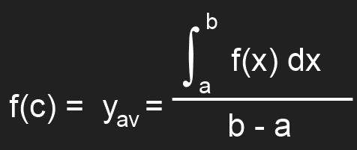
Formal Mathematical Language
If y = f(x) is continuous on the closed interval [a, b], then there is at least one point x = c in [a, b] for which
or, equivalently,

Slide 3
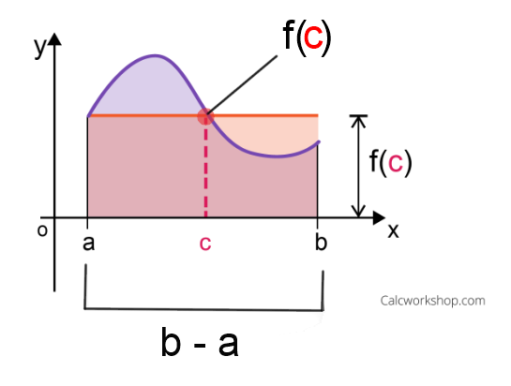
Simple Language and Visual
There is a point on a continuous function (f(c)), when made into a rectangle with the closed intervals, the area is equal to the accumulation under the curve.

Slide 4
Even Simpler Language
F(c) = Length of the rectangle
(b – a) = Width of the rectangle
A = L* W, in this case f(c) * (b – a)
This area is equal to the
accumulation under the curve.

Slide 5
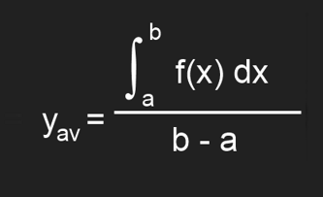
Example
a. Find the average value of the function on the given interval
b. Find a point c in the given interval for which the conclusion of the mean value theorem for definite integrals is true
f(x) = 3x² – x + 8, x ∈ [1,4]
<- Average value of a function equation

Slide 6
Example Solution
f(x) = 3x² – x + 8, x ∈ [1,4]
4
∫ ${3x}^{2}−x+8$
1.) Start off by writing the integral
1
$$x^{3}−\frac{x^{2}}{2}+8x+c$$
4
2.) Take the anti-derivative of the original function
1
$$[\left(4\right)−\frac{{\left(4\right)}^{2}}{2}+8\left(4\right)] −\text{[}{\left(1\right)}^{3}−\frac{{\left(1\right)}^{2}}{2}+8(1)]=79.5$$
3.) Use FTC to solve for the accumulation

Slide 7
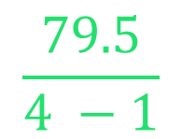
Example Solution Part 2
f(x) = 3x² – x + 8, x ∈ [1,4]
$$\frac{79.5}{4 −1}$$
5.) Divide the answer by the upper limit (b)
minus the lower limit (a)
y = 26.5
av
6.) Nice job! (That was part A)
b. “Find a point c in the given interval for which the conclusion of the mean value theorem for definite integrals is true”

Slide 8
Example Solution Part 3
f(x) = 3x² – x + 8, x ∈ [1,4]
$$26.5={3c}^{2}−c+8$$
1.) Replace ‘x’ with ‘c’ and set it equal to the average value
$$0={3c}^{2}−c −18.5$$
2.) Simplify and use the Quadratic Formula
$$c=2.6555… or −2.3222…$$
3.) ☺

Slide 9
Application
John has finally gotten his license and bought a new car and is testing it for a drive. John figures he is accelerating at $a=\frac{8}{\sqrt{t}}$. If he drove for 30 seconds and acceleration (a) = ${feet/second}^{2}$, then what was John’s average velocity in the 30 second interval?

Slide 10
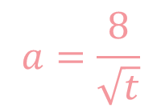
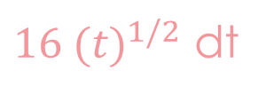
Application Solution
$$a=\frac{8}{\sqrt{t}}$$
$$a=8 {(t)}^{−1/2}$$
Rewrite
∫
$$a=8 {(t)}^{−1/2}$$
v $=16 {(t)}^{1/2}$ + c
Integrate
∫
30
$16 {(t)}^{1/2}$ dt
0
Use MVT for integrals to find the average velocity
_______________________
=
58.4237 feet/second²
30 - 0

Slide 11
Take a few minutes to do the handout
Remember the formula:

Slide 12
Solution
1.) Velocity is the antiderivative of acceleration.
2.) Acceleration is the derivative of velocity.
3.) Displacement is the antiderivative of velocity.
derivative
D V A
antiderivative

Slide 13
Solution Part 2
4.) Find the average value of y in the interval [4, 8] given y = x² – 3.
8
∫
x² – 3 dx
4
=
34.3333…
8 - 4

Slide 14
Solution Part 3
5.) Show that this average value is NOT the average of the values of y at x = 4 and x = 8.
13
61
f(4) + f(8)
34.3333
=
2
34.3333 is not equal to 37.

Slide 15
Works Cited
“Average Value Problems in Motion and Elsewhere.” Calculus: Concepts and Applications, by Paul A. Foerster, Key Curriculum Press, 2005, pp. 508–514.
Mrs. Dewey’s Quiz on 10-2 & 10-3

Slide 16
Thanks for watching!

