Slide 1
Mean Value Theorem for Derivatives
Skyler and Alina

Slide 2
Definition of MVT
If f is differentiable for all values of x in the open interval (a,b), and
f is continuous for all values x in the closed interval [a,b],
Then there are at least one number x=c in (a,b) such that

Slide 3
Informal Definition
For a function that meets the (previous) conditions, at some point the tangent line has the same slope as the secant line between the ends of the function. The secant line and the tangent line are parallel.

Slide 4
Conceptual Meaning
If there are points (a,b) on a continuous and differentiable function, there
will be a point c with a tangent line parallel to the secant line from a to b.

Slide 5
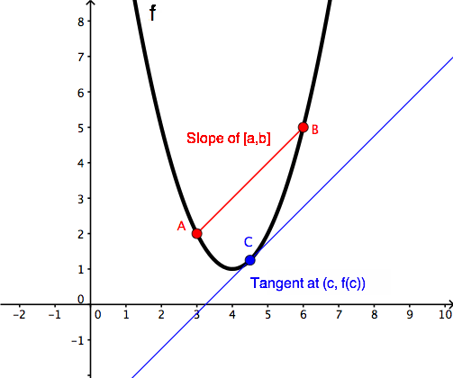
MVT Proof
https://www.wyzant.com/resources/lessons/math/calculus/differentiation/mean_value_theorem

Slide 6
Example of MVT

Slide 7
Example of MVT

Slide 8
Example of MVT, cont.

Slide 9
Application of MVT
A car enters a turnpike and the entrance time and exit time are recorded. From this, the distance, time, and average speed can be calculated. If the car's average speed is 70 mph, prove that the speed of the car was exactly 70 mph at some point between the entrance 'a' and exit 'b'.

Slide 10
Application of MTV cont.
70 mph is the slope of the secant line; therefore it is also the slope of the tangent line. There will be a point between a and b that the speed will be 70 mph.
Because the mean value theorem states that the slope of the secant line is equal to the slope of the tangent line, it is known that c will equal 70 at some point between a and b.

Slide 11
Practice Problem
Take some time to complete the practice problem provided to you.

Slide 12
Practiced Problem Solution
Yes, because it is a quadratic function, it is continuous and differentiable.

Slide 13
Works Cited
“Explore Math with Desmos.” Desmos.com, www.desmos.com/.
Foerster, Paul A. Calculus: Concepts and Applications. Key Curriculum Press, 2010.
Libretexts. “4.2: The Mean Value Theorem.” Mathematics LibreTexts, Libretexts, 27 Apr. 2019, math.libretexts.org/Bookshelves/Calculus/Map:_University_Calculus_(Hass_et_al.)/4:_Applications_of_Definite_Integrals/4.2:_The_Mean_Value_Theorem.
“Mean Value Theorem Explanation.” Mean Value Theorem | Wyzant Resources, www.wyzant.com/resources/lessons/math/calculus/differentiation/mean_value_theorem.
“Real World Application of Mean Value Theorem.” Chegg, Chegg Study, www.chegg.com/homework-help/questions-and-answers/example-1-real-world-application-mean-value-theorem-two-stationary-police-cars-equipped-ra-q29403958.

Slide 14
Thanks for Watching
Any Questions?

