Slide 1
Fundamental Theorem of Calculus
Derivative of an Integral
Jessie and Joshua

Slide 2
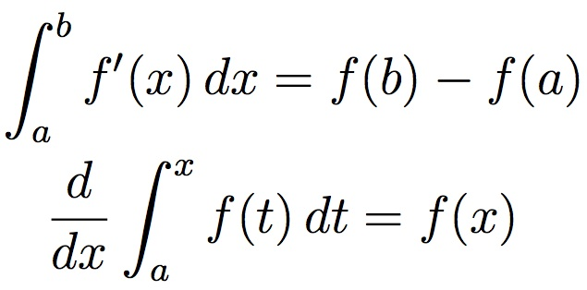
What is it?
What does this mean?
The Fundamental of Calculus - Derivative of an Integral Form
If where a is any constant, and if f is continuous around a, then
https://mathcs.clarku.edu/~ma121/

Slide 3
Conceptual Meaning
The Fundamental Theorem of Calculus Part Two relates a definite integral to the net change of the antiderivative
In other words, taking the derivative of an integral!

Slide 4
Quick Examples
Chain Rule for this one would be multiplied by 1, so no need to worry about it
Chain Rule for this one would be multiplied by 2, so it is multiplied in the front just to make it easier to read

Slide 6
Worksheet

Slide 7
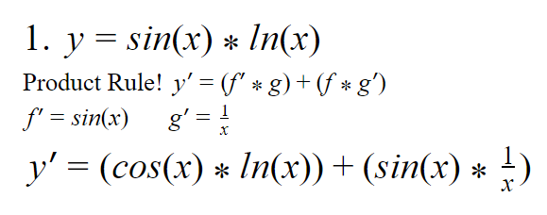

Slide 8
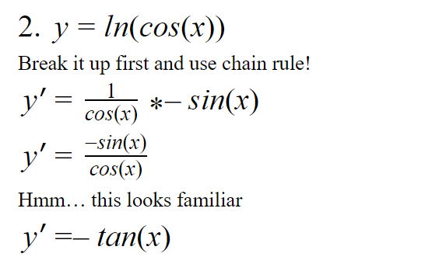
The derivative of ln(x) is 1/x. Since cos(x) is inside the parentheses for the ln(x), it needs to be left alone and go in the denominator of the derivative of the ln(x)
Then because of chain rule, need to multiply by the derivative of the cos(x), which is the -sin(x)

Slide 9
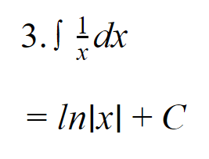
Following the given rule for the antiderivative of 1/x, the answer is simply the ln|x|+C
Need to include C as a constant because we don’t know if there was an alone integer in the original equation

Slide 10
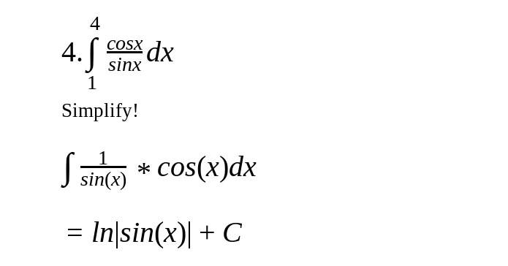
When you simplify/take apart the fraction, cos(x) is the derivative of sin(x), which is the chain rule!
Then, following the given rule for the antiderivative of 1/sin(x), the answer is the ln|sin(x)|+C
Just like problem 2, the sin(x) is inside the parentheses of the ln(x), so it needs to be left alone in the denominator
Again, C is included as a constant because we don’t know if there was an alone integer in the original equation

Slide 11
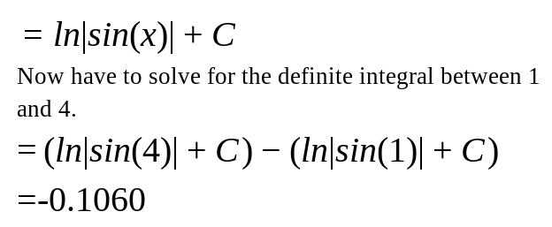
The constants will cancel out because it is C-C, which is just zero

Slide 12
Real Life Application
An object has a total distance traveled of d(x)= meters. Use the fundamental theorem of calculus to find an equation for the rate of change of the distance, or velocity, the object has traveled.

Slide 13
Works Cited
Khan, Sal. “The Fundamental Theorem of Calculus and Definite Integrals.” Khan Academy, Khan Academy, www.khanacademy.org/math/ap-calculus-ab/ab-integration-new/ab-6-7/v/connecting-the-first-and-second-fundamental-theorems-of-calculus.
Foerster, Paul A. Calculus: Concepts and Applications. 2nd ed., Key Curriculum Press, 2010. 270-80.
Winders, M, et al. Math 121 Calculus II, Clark University, mathcs.clarku.edu/~ma121/.

Slide 14
Thank You for Watching!
Any Questions?

