Slide 1
Intermediate Value Theorem
Darius & Ryan

Slide 2
Formal Definition
If f is continuous for all x in the closed interval [a,b], and y is a number between f(a) and f(b), then there is a number x = c in (a,b) for which f(c) = y.

Slide 3
Informal Definition
If a function is continuous between a and b, for any value between f(a) and f(b), there is a value c.

Slide 4
Conclusion for IVT
For any L between the values f(a) and f(b), there exists a number c in [a,b] for which f(c)= L.

Slide 5
Conceptual Meaning
Must be continuous from [a,b]
f(c) is between the values of f(a) and f(b)
Therefore c is a value within the interval [a,b]

Slide 6
Example #1
Big D is building a fenced in yard for his friend Puff Daddy. He finds that in order to match the house perfectly he needs an area of 5 square acres, but isn’t sure whether a certain length exists that could give him that area. The minimum length of the yard is 2 acres and the maximum is 4, and the area of the yard can be represented by a function F. F is a continuous function on the closed interval [2,4], where F(2)=3 and F(4)=8. Applying IVT, we find that F(c)=5 square acres for at least one length of c between 2 and 4.

Slide 7
Example #2
Is there a solution to f(x)= 3x +5 between x= 3 and x= 5?
Graph function to verify that it’s continuous [3,5].
Pick a value between f(3) and f(5).
Solve for x.

Slide 8
Work on Handout

Slide 9
Problem #1

Slide 10
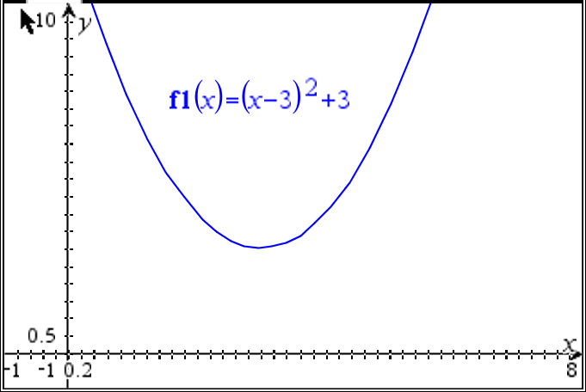
Problem #2

Slide 11
Problem #2 (con.)

Slide 12
Works Cited
Arizona State University.” Intermediate Value Theorem, Rutgers University, www.asu.edu/.
Dutton, Judy. Science Fair Season: Twelve Kids, a Robot Named Scorch-- and What It Takes to Win. Hyperion Books, 2011.
Hampson, Michelle. “Huge Reservoir of Liquid Water Detected Under Surface of Mars.” AAAS - The World's Largest General Scientific Society, 25 July 2018, www.aaas.org/news/huge-reservoir-liquid-water-detected-under-surface-mars.
Dutton, Judy. Science Fair Season: Twelve Kids, a Robot Named Scorch-- and What It Takes to Win. Yaboi.

Slide 13
Thank You for Watching

