Slide 1
Probability Jeopardy
Simple Probabilities | Arrange-ments + | Counting Principle | Find the Probability | Compound Events | Potpourri
Q $100 | Q $100 | Q $100 | Q $100 | Q $100 | Q $100
Q $200 | Q $200 | Q $200 | Q $200 | Q $200 | Q $200
Q $300 | Q $300 | Q $300 | Q $300 | Q $300 | Q $300
Q $400 | Q $400 | Q $400 | Q $400 | Q $400 | Q $400
Q $500 | Q $500 | Q $500 | Q $500 | Q $500 | Q $500
Final Jeopardy

Slide 2
$100 Question from Simple Probabilities
What is the probability of rolling a 2 when a fair die is rolled once?

Slide 3
$100 Answer from Simple Probabilities
1/6

Slide 4
$200 Question from Simple Probabilities
What is the probability of rolling an even number when a fair die is rolled once?

Slide 5
$200 Answer from Simple Probabilities
½

Slide 6
$300 Question from Simple Probabilities
What is the probability that a card drawn at random from a deck of cards will be an ace ?

Slide 7
$300 Answer from Simple Probabilities

Slide 8
$400 Question from Simple Probabilities
What is the probability that when a pair of six-sided dice are thrown, the sum of the numbers equals 5?

Slide 9
$400 Answer from Simple Probabilities

Slide 10
$500 Question from Simple Probabilities
A book contains 32 pages numbered 1, 2, ..., 32. If a student randomly opens the book, what is the probability that the page number contains digit 1?

Slide 11
$500 Answer from Simple Probabilities
1,10,11,12,13,14,15,16,17,18,19,21,31
.40625

Slide 12
$100 Question from Arrangements +
What is a formula for permutations?

Slide 13
$100 Answer from Arrangements +
_{n}P_{r} = $\frac{n!}{\left(n−r\right)!}$

Slide 14
$200 Question from Arrangements +
How many ways can 10 songs be arranged on a CD-R?

Slide 15
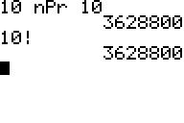
$200 Answer from Arrangements +
Permutation

Slide 16
$300 Question from Arrangements +
Your phone needs a code to unlock. How many 5-digit codes are possible with no repeating digits?

Slide 17
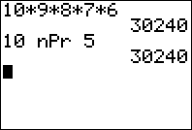
$300 Answer from Arrangements +
Permutations

Slide 18
$400 Question from Arrangements +
What is the probability of rolling a 3 or 6 on a number cube, tossing a heads on a coin, and spinning a 2 on a spinner divided into 6 equal sections?

Slide 19
$400 Answer from Arrangements +
1/3 • 1/2 • 1/6 = 1/36

Slide 20
$500 Question from Arrangements +
How many sets of Secretary, Treasurer, and Historian can be selected from a group of 10?

Slide 21
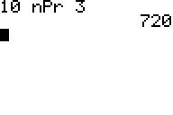
$500 Answer from Arrangements +
Permutations

Slide 22
$100 Question from Counting Principle
William wants a sandwich and a drink for lunch. If a restaurant has 4 choices of sandwiches and 3 choices of drinks, how many different ways can he order his lunch?

Slide 23
$100 Answer from Counting Principle
12

Slide 24
$200 Question from Counting Principle
In how many arrangements can a teacher seat 3 girls and 3 boys in a row of 6 if the boys are to have the first, third, and fifth seats?

Slide 25
$200 Answer from Counting Principle
36 = (3)(3)(2)(2)(1)(1)

Slide 26
$300 Question from Counting Principle
If a customer makes exactly 1 selection from each of the 5 categories listed below, what is the greatest number of different ice cream sundaes that a customer can create?
12 ice cream flavors;
10 kinds of candy;
8 liquid toppings;
5 kinds of nuts;
With or without whip cream;

Slide 27
$300 Answer from Counting Principle
9600=(12)(10)(8)(5)(2)

Slide 28
$400 Question from Counting Principle
You are at your school cafeteria that allows you to choose a lunch meal from a set menu. You have two choices for the Main course (a hot dog or a hamburger), Two choices of a drink (orange juice, apple juice) and Three choices of dessert(pie, ice cream, jello). How many different meal combos can you select?

Slide 29
$400 Answer from Counting Principle
12

Slide 30
$500 Question from Counting Principle
Licence Plates for cars are labeled with 3 letters followed by 3 digits.(in this case, digits refer to digits 0 - 9. If a question asks for numbers, its 1 - 9 because 0 isn't really a number)
How many possible plates are there? You can use the same number more than once.

Slide 31
$500 Answer from Counting Principle
(26)(26)(26)(10)(10)(10) = 17,576,000

Slide 32
$100 Question from Find the Probability
When a single card is drawn from a standard deck of cards, what is the probability of getting a
5 or a king?

Slide 33
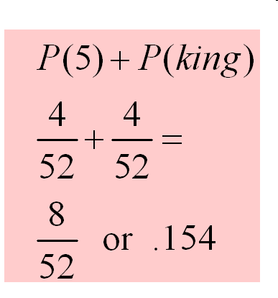
$100 Answer from Find the Probability

Slide 34
$200 Question from Find the Probability
When a single card is drawn from a standard deck of cards, what is the probability of getting a 2 or a red card?

Slide 35
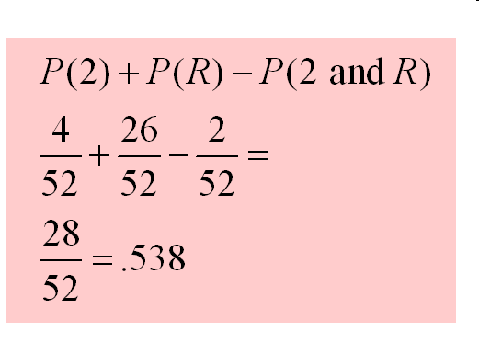
$200 Answer from Find the Probability

Slide 36
$300 Question from Find the Probability
The probability that a person owns a microwave oven is 0.75, that a person owns a CD player is .25 and that a person owns both a microwave and a CD player is 0.16. Find the probability that a person owns either a microwave OR a CD player.

Slide 37
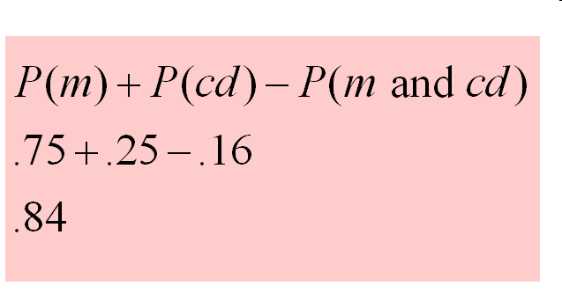
$300 Answer from Find the Probability

Slide 38
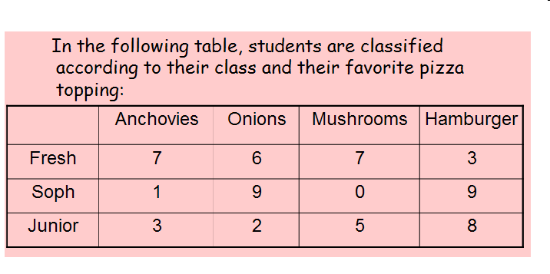
$400 Question from Find the Probability
Find the probability if a student is selected
At random that they are a freshmen or likes onions?

Slide 39
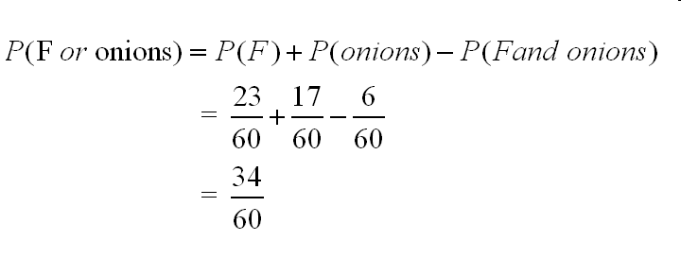
$400 Answer from Find the Probability

Slide 40
$500 Question from Find the Probability
Find the indicated probability.
P(A) = 0.3
P(B) = 0.5
P(A and B) = 0.6
P(A or B) = ?

Slide 41
$500 Answer from Find the Probability
P(A or B)= P(A) +P(B) – P(A and B)
= 0.3 + 0.5 - 0.6
= 0.2

Slide 42
$100 Question from Compound Events
Find the probability that when
tossing a coin 2 times you
will get tails both times.

Slide 43
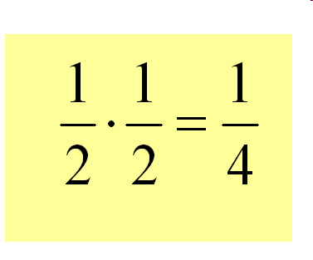
$100 Answer from Compound Events

Slide 44
$200 Question from Compound Events
A coin is tossed and a card is drawn
from an ordinary deck of cards.
Find the probability of getting a
head on the coin and a red card.

Slide 45
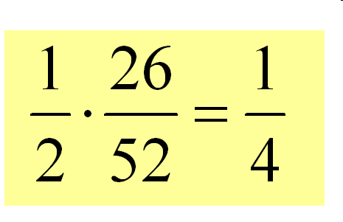
$200 Answer from Compound Events

Slide 46
$300 Question from Compound Events
P(A) = 0.7
P (not A) = ?

Slide 47
$300 Answer from Compound Events
P (not A) = 0.3

Slide 48
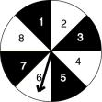
$400 Question from Compound Events
For this spinner, what is the probability of landing on a multiple of 3 on the first spin and a factor of 12 on the second spin?

Slide 49
$400 Answer from Compound Events

Slide 50
$500 Question from Compound Events
Events A and B are independent.
Find the indicated probability.
P (A) = 0.4
P(B) = 0.2
P(A and B) = ?

Slide 51
$500 Answer from Compound Events
P(A and B) = P(A)*P(B)
= 0.4 * 0.2
= 0. 08

Slide 52
$100 Question from Potpourri
What is the probability of getting a heads or a tails when flipping a fair coin?

Slide 53
$100 Answer from Potpourri

Slide 54
$200 Question from Potpourri
You have a container filled with eight pieces of green paper and six pieces of blue paper. What is the probability of choosing, a green piece of paper, then a blue paper without replacement?

Slide 55
$200 Answer from Potpourri

Slide 56
$300 Question from Potpourri
David flipped a fair coin 100 times and the coin landed on tails 75 times. What is the probability that this coin will land on heads the next flip?

Slide 57
$300 Answer from Potpourri

Slide 58
$400 Question from Potpourri
A bag contains 10 red and 6 blue marbles. A person selects two marbles without replacement. Find the probability of selecting 2 blue marbles.

Slide 59
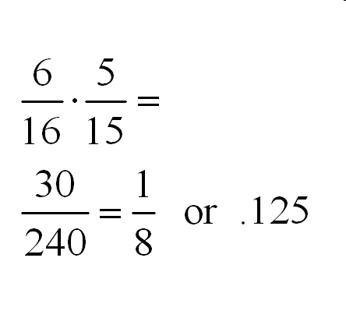
$400 Answer from Potpourri

Slide 60
$500 Question from Potpourri
A flashlight has a total of 6 batteries, two of which are defective. If two batteries are selected at random without replacement, find the probability that both are defective.

Slide 61
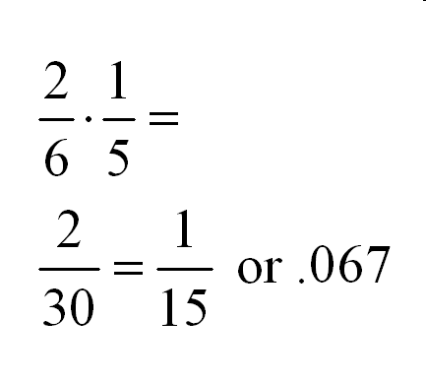
$500 Answer from Potpourri

Slide 62
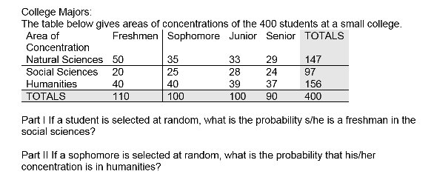
Final Jeopardy

Slide 63
Final Jeopardy Answer

